Slide 1
Lenin and Stalin
Assessing Different Adaptations of Communism

Slide 2
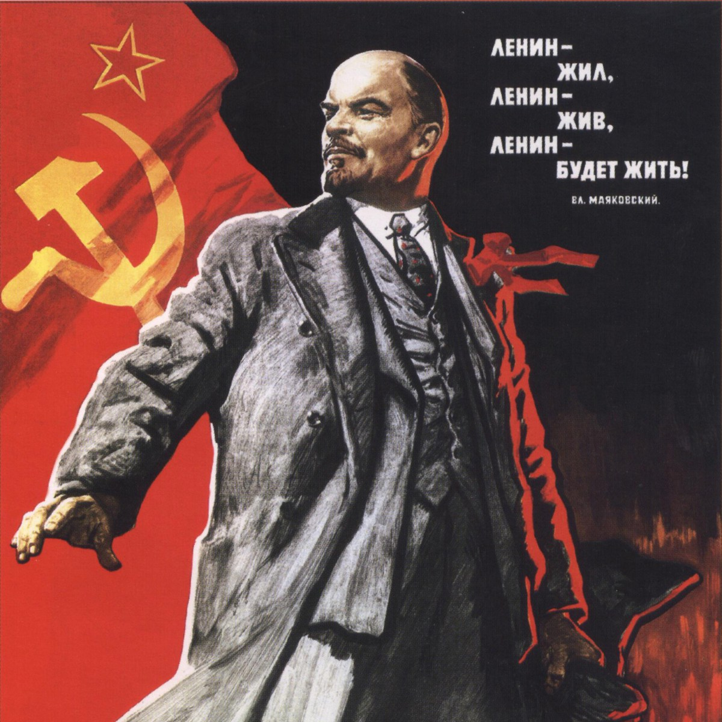
Lenin Upbringing
Born on April 22, 1870 in Simbirsk, Russia.
Original name was Vladimir Ilyich Ulyanov but later changed it to Lenin.
Raised in a comfortable environment as he had wealthy and respectable parents.

Slide 3
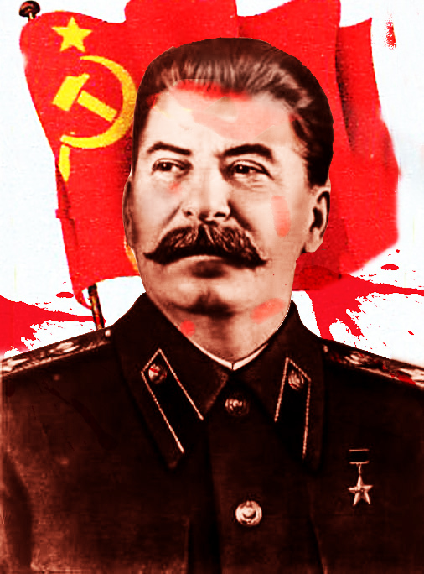
Stalin Upbringing
Born as Iosif Vissarionovich Dzhugashvili on December 21, 1879 in Gori, Georgia. Later changed his name to Stalin.
Stalin was born in a poor and difficult environment as his parents came from the lower social and economic classes.
He assumed adult responsibilities from a young age due to the lack of positive parental influence.
The difficult upbringing led to Stalin developing a personality of strict and no-nonsense leadership.

Slide 4
Communism Adaptations
Lenin
He was determined to spread communism as the main social system.
Emphasized on empowering common citizens.
Main aim was to develop a society characterized by class divisions.
Stalin
Determined to gain authoritarian control through communism.
Enforced labor camps for low social and economic classes.
Insisted on single party politics.

Slide 5
Lenin Social Policies
Reduced the influence of the church on political and social issues.
Transferred influence from the church to the government, controlled by the Bolsheviks.
Centralized and nationalized the economy to eliminate alienation of the peasantry.
Developed a system of forceful distribution of economic resources to people across all classes.
Allowed peasants to pay taxes using their produce, hire labor, and rent additional land.

Slide 6
Stalin Social Policies
Established authoritative control over media to influence the masses through propagandist messages in radio, television, print and film.
Introduced indoctrination policies in the education sector to influence citizens from a young age and spread his views to the next generations.
Expanded the workforce by allowing women to join the national workforce. This move was aimed at meeting the increased global demand for labor and production.

Slide 7
Lenin Economic Policies
Introduced the New Economic Policy (NEP) to help the state achieve economic prosperity.
The NEP favored capitalism over socialism but critics argued that it had excessive emphasis on a free market economic system.
Nationalized manufacturing and retail sectors to accomplish even distribution and effective utilization of resources.
Introduced the tax option of paying through produce, allowed peasantry to participate in the free market.
Oversaw the reopening and rebuilding of factories to address the need for varied capital generation sources.

Slide 8
Stalin Economic Policies
Introduced the Five-Year Plans to assist in the modernization of Russia in the emerging world of the 20th century.
Main goals of the economic policies were to electrify Russia, develop the steel industry and increase mining of natural resources.
Mechanized and modernized the agricultural sector that had been previously lacking in technical equipment and knowledge.
Introduced collectivization to place emphasis on the communist over the capitalist way of life. Collectivization required land to be combined into large collective farms where all peasants could do their farming.

Slide 9
Lenin Strategic Thinking
Oversaw a transformation of the state from an imperial system to an anti-imperialist country.
Had the ability to mobilize the masses to quell revolts including the revolt headed by Kornilov.
Instilled Marxist leadership and mentality in the party and in the Russian people.
Exhibited deep strategic ability of when to make tactical retreats and when to initiate attacks.
Set the foundation for major economic policies used by his successors and in other countries of the world.
Developed the theory that different states could exist with different social systems simultaneously after introduction of a proletarian revolution.
His critique of imperialism defined 20th century understanding of socialism.

Slide 10
Stalin Strategic Thinking
Shared similar ideals on communism with Lenin but implemented them in a more forceful way.
Developed an international policy that united business people, peasants, workers and professionals against Fascism.
Used an imperative strategy to encourage people in colonial and capitalist countries to adopt democracy.
Emphasized on a world peace policy aimed at non-aggression pacts in a highly volatile global environment with World War II pending.
Believed that organization was the most important factor in political life.
Used isolationist tactics in his foreign policies.

Slide 11
Conclusion
Lenin and Stalin shared some similarities in their communist and Marxist beliefs but practiced different styles of rulership.
Lenin was a strong leader but focused more on social and economic empowerment of the people, particularly the lower classes.
Stalin was an authoritative leader who used force and brutality to gain more power as an individual.
The two leaders developed social and economic policies that were primarily communist in nature but Stalin did not favor the capitalist support structure that Lenin preferred.
Stalin misused policy to advance his personal drive for power while Lenin attempted to introduce policies that would have a long-term and global effect.

Slide 12
References
Carroll, W. K., & Ratner, R. S. (1994). Between Leninism and radical pluralism: Gramscian reflections on counter-hegemony and the new social movements. Critical Sociology, 20(2), 3-26.
Dougherty, J. E. (1997). Contending theories of international relations: A comprehensive survey. Addison Wesley Publishing Company.
Fitzpatrick, S. (2000). Everyday Stalinism: ordinary life in extraordinary times: Soviet Russia in the 1930s. Oxford University Press, USA.
Groys, B. (2014). The total art of Stalinism: Avant-Garde, aesthetic dictatorship, and beyond. Verso Books.
Kotkin, S. (1997). Magnetic mountain: Stalinism as a civilization. University of California Press.
Kubálková, V., & Cruickshank, A. (2015). Marxism-Leninism and the theory of international relations (Vol. 4). Routledge.
Lenin, V. I., & Chretien, T. (2015). State and revolution. Haymarket Books.
Luxemburg, R. (1961). The Russian Revolution, and Leninism Or Marxism? University of Michigan Press.
Priestland, D. (2007). Stalinism and the politics of mobilization: ideas, power, and terror in inter-war Russia. Oxford University Press.
Tucker, R. C. (1972). The Soviet political mind: Stalinism and post-Stalin change (No. 582). WW Norton & Company.

